Slide 1
Policy networks for Non-Markovian
Deep RL Rewards
ANTONELLA ANGRISANI, ANDREA FANTI and LUCA LOBEFARO

Slide 2
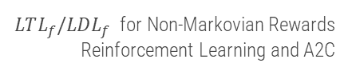
INTRODUCTION
01
BACKGROUND
02
AGENT AND ENVIRONMENT
TABLE OF CONTENTS
03
EXPERIMENTS
04
CONCLUSIONS
05
Theoretical and experimental context
Description of the environment and the approach used
Experiments performed and results
Conclusions and Future Works

Slide 3
01
INTRODUCTION
Theoretical and experimental context

Slide 4
Temporal Goals with Reinforcement Learning
We can use Reinforcement Learning to solve Temporal Goals
However, temporal goals are non-Markovian
Simply appending DFA state and feeding to the agent network(s) does not work
Extend the MDP with a DFA
Use |Q| separate networks (baseline)
Possible improvement for training time: share layers

Slide 5
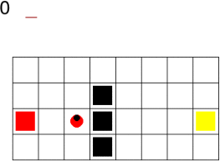
Experiment Setting
SapientinoCase environment
Advantage Actor-Critic
Actor-Critic family: learn both policy and value separately
On-policy
Uses the Advantage as baseline
Low dimensional observation space: no need for CNNs
Task can be simplified/made harder by simply changing the map

Slide 6

02
BACKGROUND

Slide 7
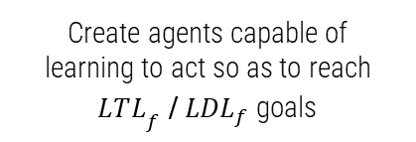
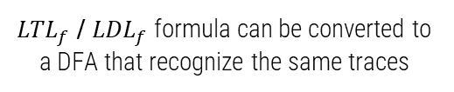
MARKOV ASSUMPTION
TEMPORAL SPECIFICATIONS
NON-MARKOVIAN REWARDS
Action’s effects depend only on the state in which it was executed, and a reward given at a state only on the previous action and state
The reward depends on the state history rather than the last one only
WHY?

Slide 8
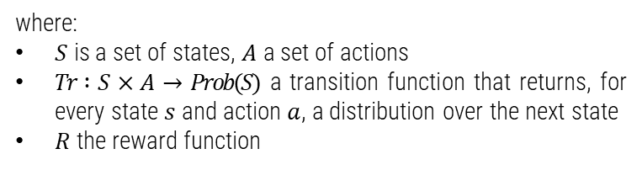
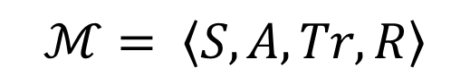
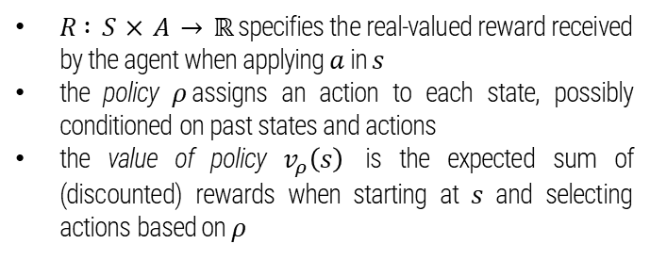
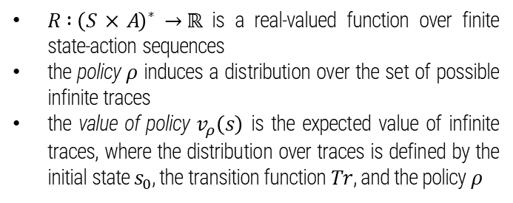
MARKOV
DECISION PROCESS
NON-MARKOV-REWARD DECISION PROCESS

Slide 9
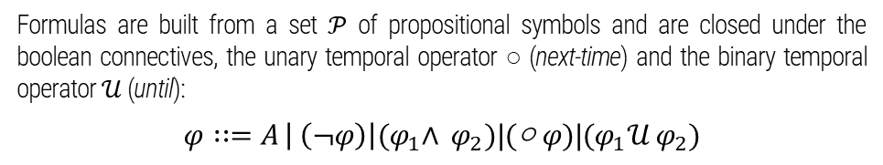
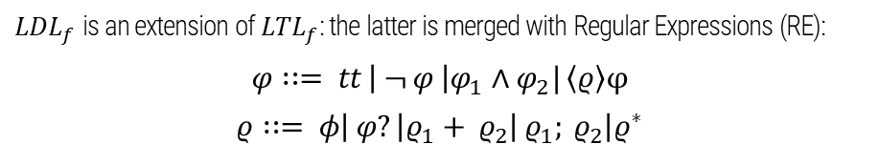
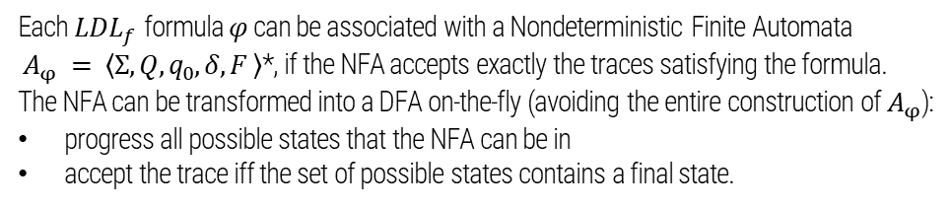
LTL_{f} / LDL_{f}
Linear Temporal Logic (LTL)
over finite traces
Linear Dynamic Logic (LDL)
over finite traces
Deterministic Finite Automata (DFA)

Slide 10
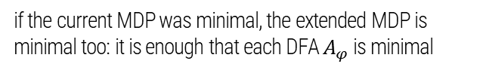
LDL_{f} advantages
01
greater expressivity, and possibility to represent also procedural constraints (sequencing constraints)
ENHANCED EXPRESSIVE POWER
02
MINIMALITY AND COMPOSITIONALITY
if a new formula is added, we need simply to extend MDP with one additional component.
03
to ensure, on the base of the initial state, the generation of reachable states only
FORWARD CONSTRUCTION VIA PROGRESSION

Slide 11
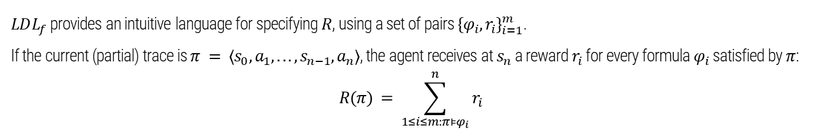
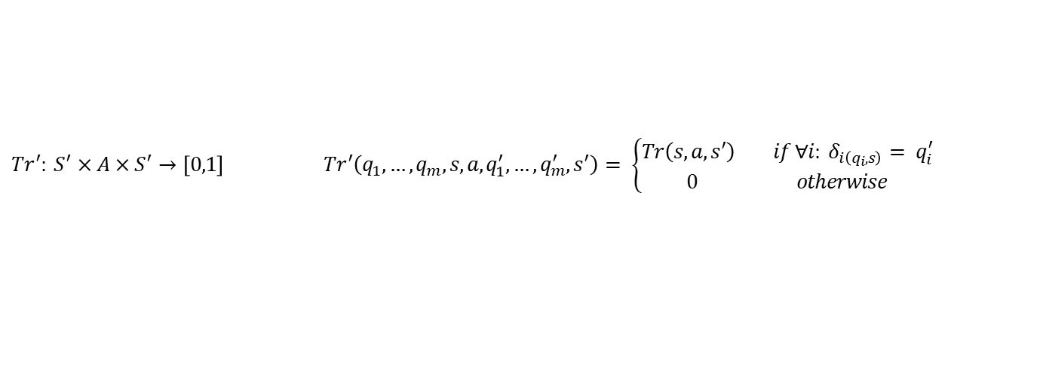
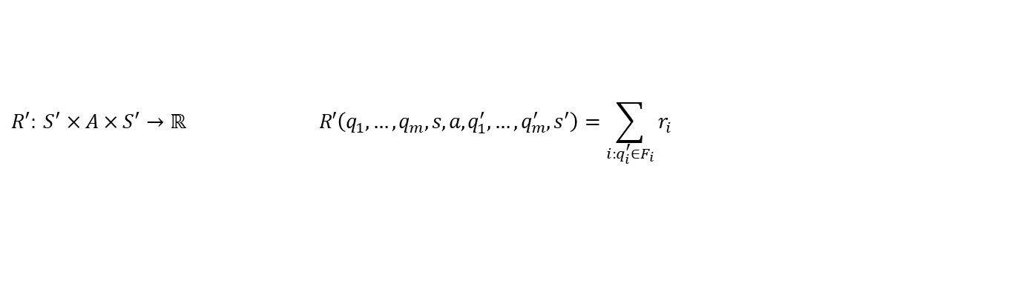
Non-Markovian-Rewards

Slide 12
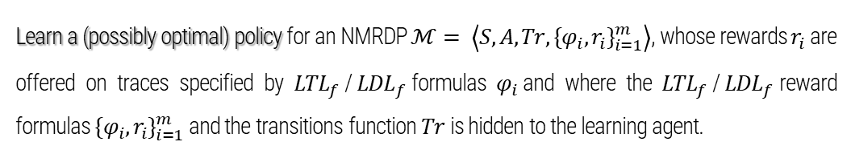
RL for NMRDP with LTL_{f} LDL_{f} rewards

Slide 13
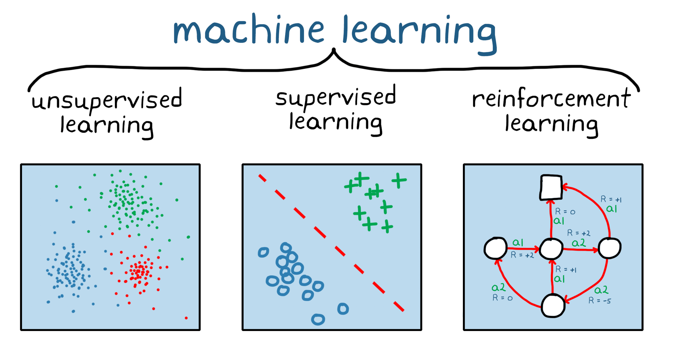
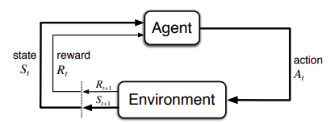
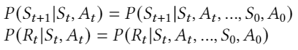
What is Reinforcement Learning?
Markov properties:

Slide 14
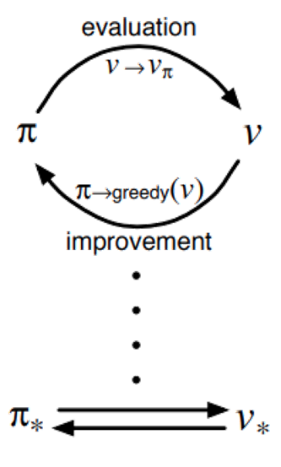
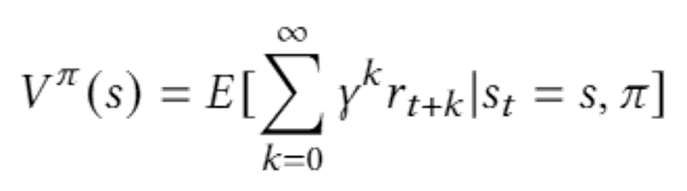
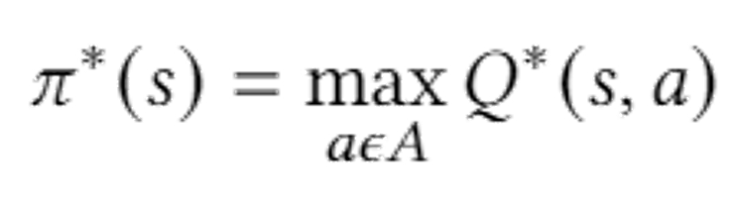
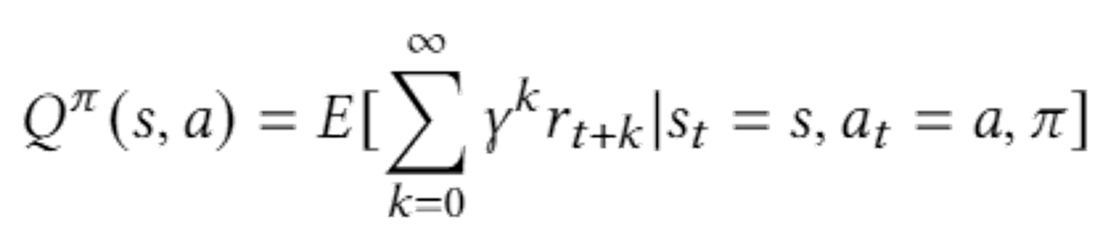
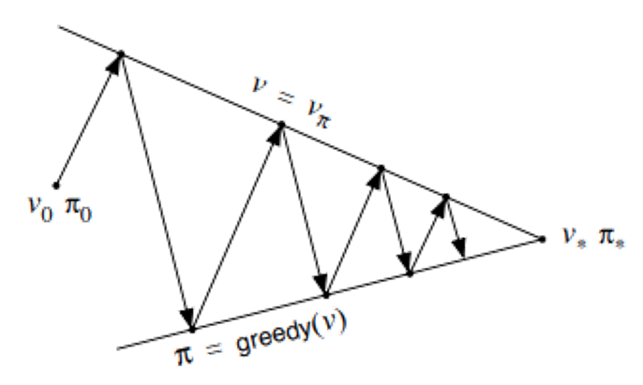
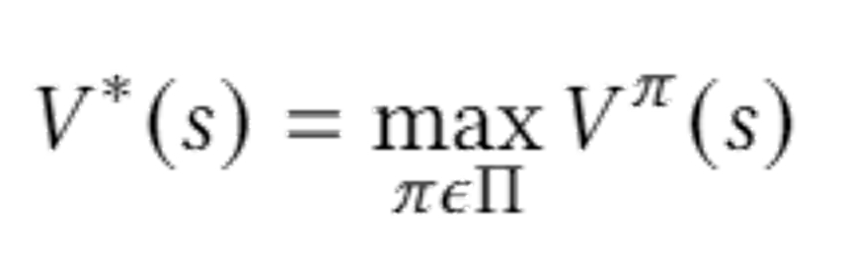
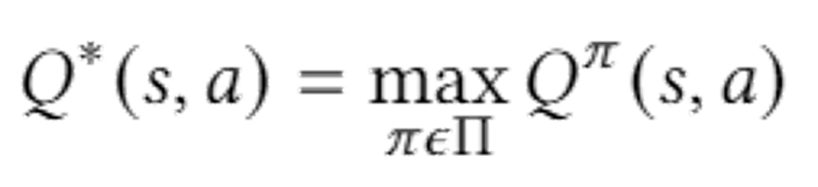
How an agent can learn from experience
It has to learn an optimal policy
An optimal policy maximize the expected return
V-value function
Q-value function
The optimal policy is computed as:
where:

Slide 15
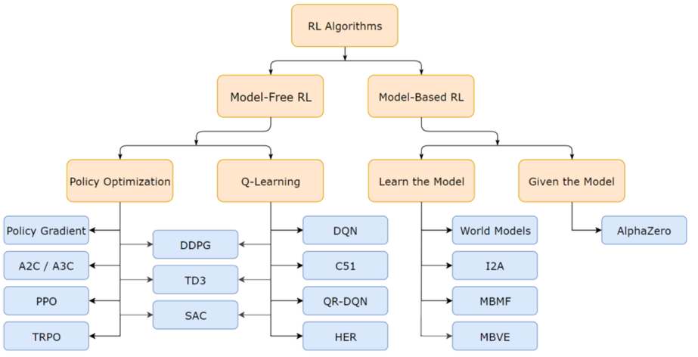
Types of RL algorithms

Slide 16
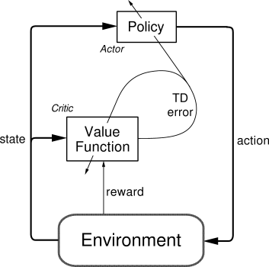
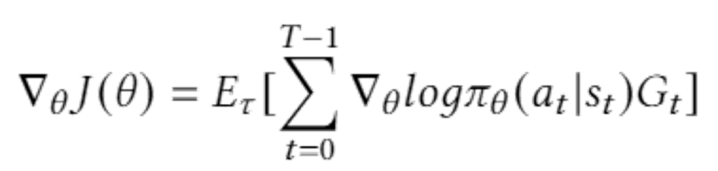
Actor-Critic
The Actor network approximates the policy function
The Critic network approximates the value function
Policy gradient:
Problems of this formulation:
high variability in log probabilities
noisy gradients
unstable learning

Slide 17
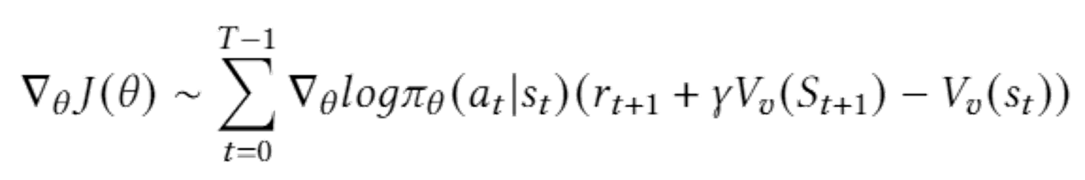
Advantage Actor-Critic (A2C)
To solve unstability a baseline is introduced, the Advantage:
Then we obtain:
(it tells about the extra reward that could be obtained by the agent by taking that particular action and it is computed using the TD Error estimator that is the difference between consecutive temporal predictions)

Slide 18
03
AGENT AND ENVIRONMENT
SapientinoCase and Agent models

Slide 19
SapientinoCase
A unicycle robot navigates a 2d grid
Cells can be empty, full, colored
(non-Markovian) goal is to “visit” colored cells in a specific order

Slide 20
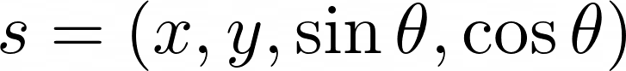
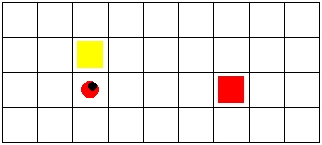
Observations
Continuous in the form
x
y
θ

Slide 21

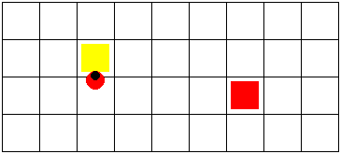
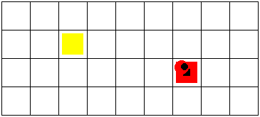

Actions
Discrete in 0..4
0 (turn left)
1 (turn right)
2 (forward)
3 (beep/visit)
4 (no-op)

Slide 22
Non-Markovian Goal
The reward depends on previous transitions → non-Markovian
Use the approach from “𝐿𝑇𝐿𝑓/𝐿𝐷𝐿𝑓 Non-Markovian Rewards” (Brafman, De Giacomo, Patrizi 2018):
Use a temporal formula to model the reward
Compute the associated DFA
Augment the base environment state with the DFA state and reward
This makes it possible to integrate non-Markovian goals in an MDP by producing an extended MDP

Slide 23
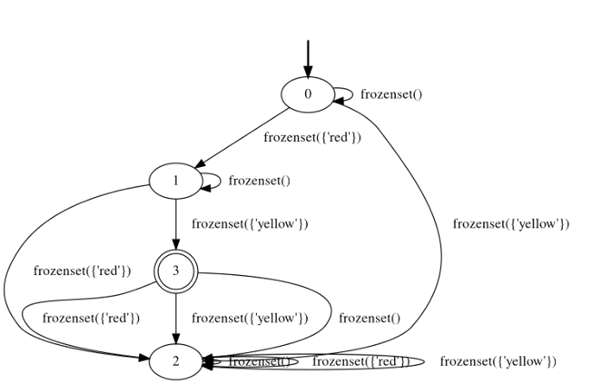
Generated DFA
Example DFA for the 2 colors case
In our simple case, the DFA was generated manually (not automatically from a temporal formula)
N + 2 states (for each color + initial and sink)
Transition to next color when on the correct cell and last action was visit
Transition to sink whenever wrong color is visited

Slide 24
Actor model(s): Baseline
Baseline approach: N identical separate networks, one for each automaton state
Actor model(s)
Critic model(s)
Linear (64)
Linear (64)
Tanh
ReLU
Linear (32)
Linear (32)
Tanh
ReLU
Linear (5)
Linear (1)
Softmax

Slide 25
Possible Improvement
Share layers (up to the second last)
Actor shared
feature extractor
Critic shared
feature extractor
Linear (64)
Actor separate output module
Linear (64)
Critic separate output module
Tanh
Linear (5)
Tanh
Linear (1)
Linear (32)
Softmax
Linear (32)
Tanh
Tanh

Slide 26
Implementation (PyTorch)
Subclass Module and use ModuleList to store all of the networks
For the shared configuration, have a common network and separated output layers
The correct network/output layer is selected in the forward method by indexing the ModuleList with the automaton state

Slide 27
04
EXPERIMENTS
Experiments performed and results obtained

Slide 28
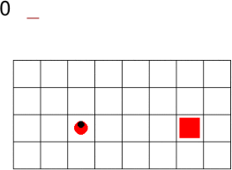
Simpler case: 1 color
PARAMETERS
max time-steps: 300
learning rate: 1e-3
gamma: 0.99
episodes: 2700

Slide 29
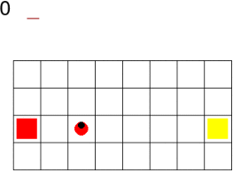
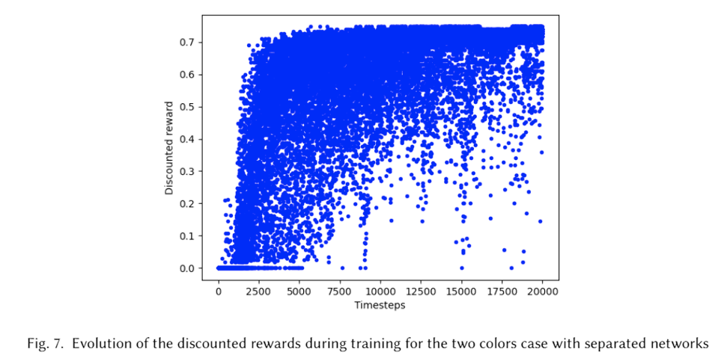
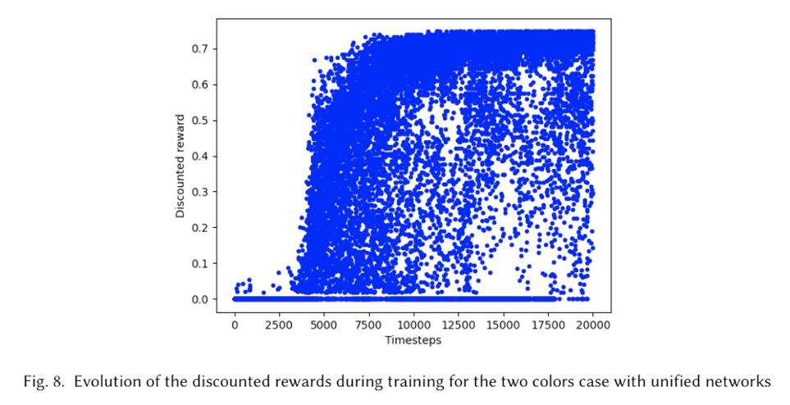
Non-Markovian Setting: 2 colors
PARAMETERS
max time-steps: 400
learning rate: 5e-4
gamma: 0.99

Slide 30
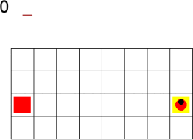
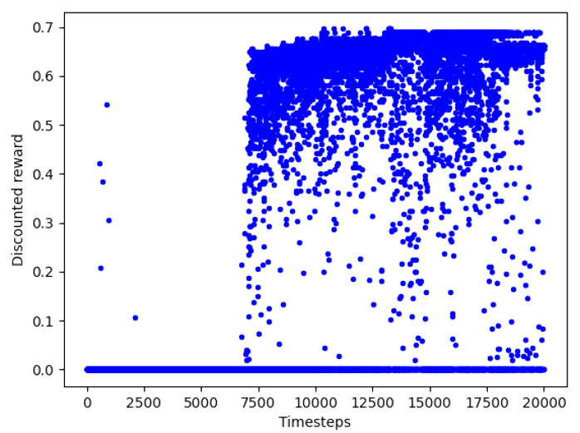
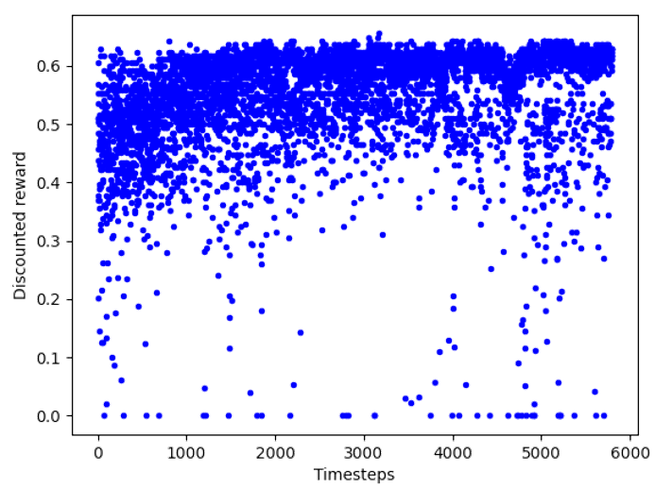
Transfer Learning
PARAMETERS
max time-steps: 400
learning rate: 5e-4
gamma: 0.99

Slide 31
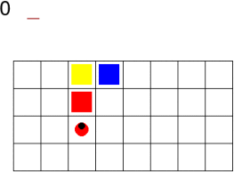
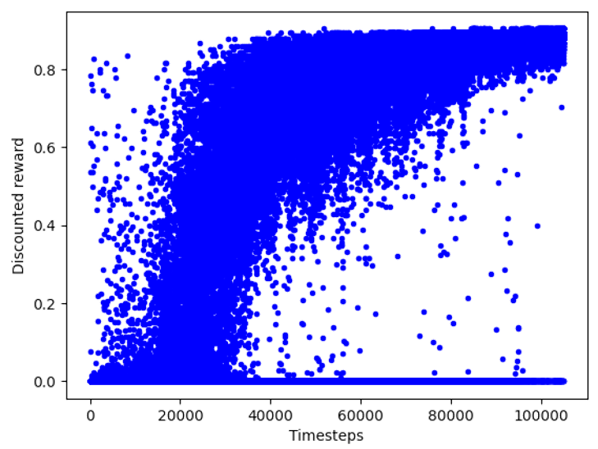
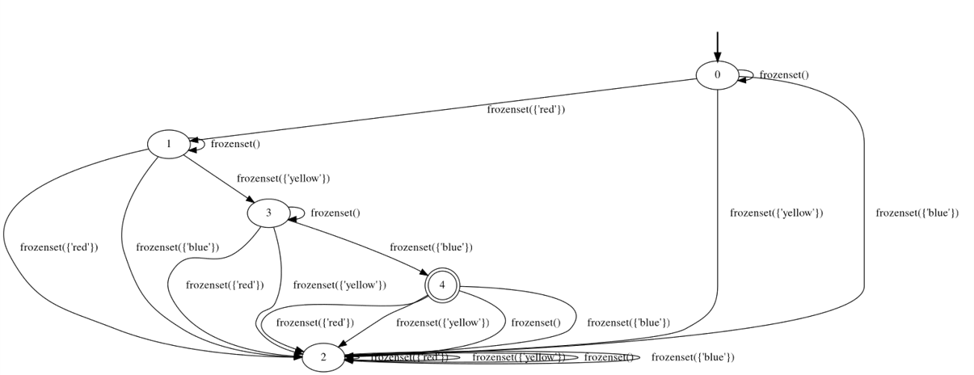
3 colors setting

Slide 32
05
CONCLUSIONS
Conclusions and Future Works

Slide 33
Conclusions
A shared neural architecture is able to accomplish a non-Markovian task in the same amount of time of the baseline but with less memory
With a pre-trained model we can solve harder configurations in a sensible less amount of episodes
EXTENSIONS
A three color map with an harder configuration
More than two colors with reward shaping
A more complex environment (e.g. Atari gym environments)

Slide 34
Thanks for the Attention

